Slide 1
Investment Casting (Lost Wax Process)
A pattern made of wax is coated with a refractory material to make mold, after which wax is melted away prior to pouring molten metal
It is a precision casting process - capable of castings of high accuracy and intricate detail

Slide 2
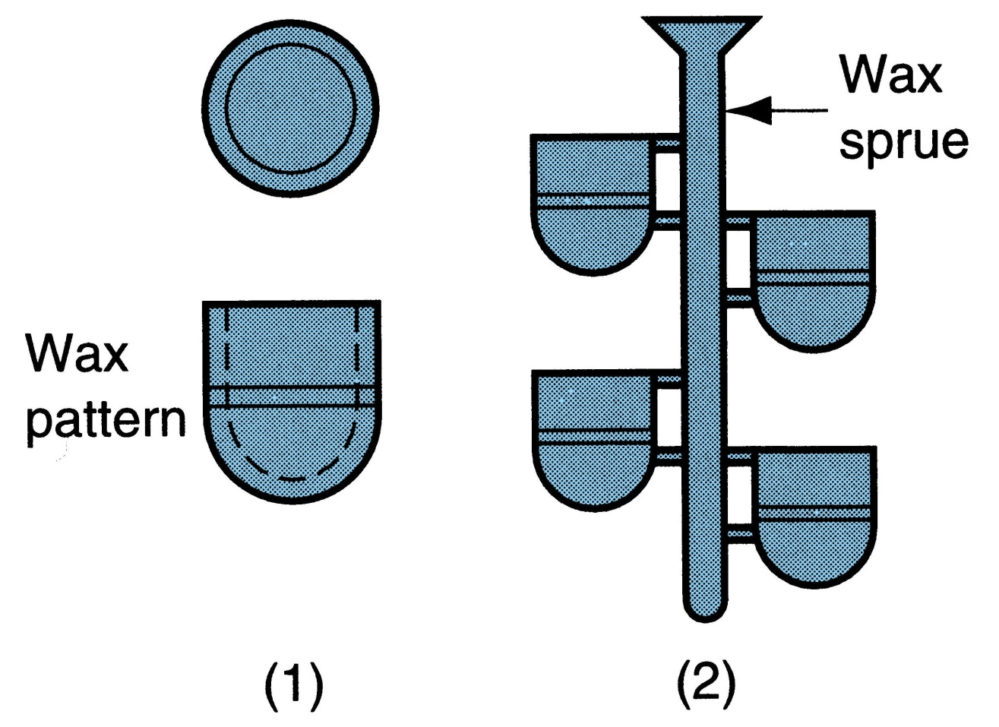
Steps
1. wax patterns are produced
2. several patterns are attached to a sprue to form a pattern tree

Slide 3
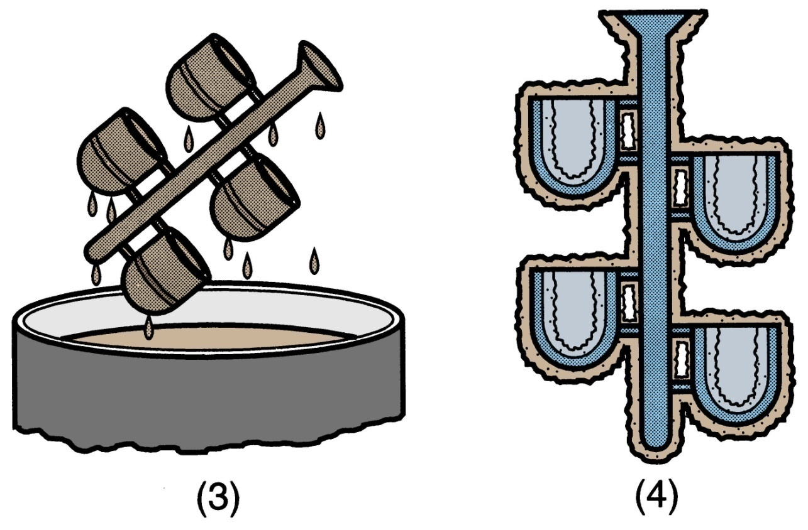
Steps :
(3) the pattern tree is coated with a thin layer of refractory material
(4) the full mold is formed by covering the coated tree with sufficient refractory material to make it rigid

Slide 4
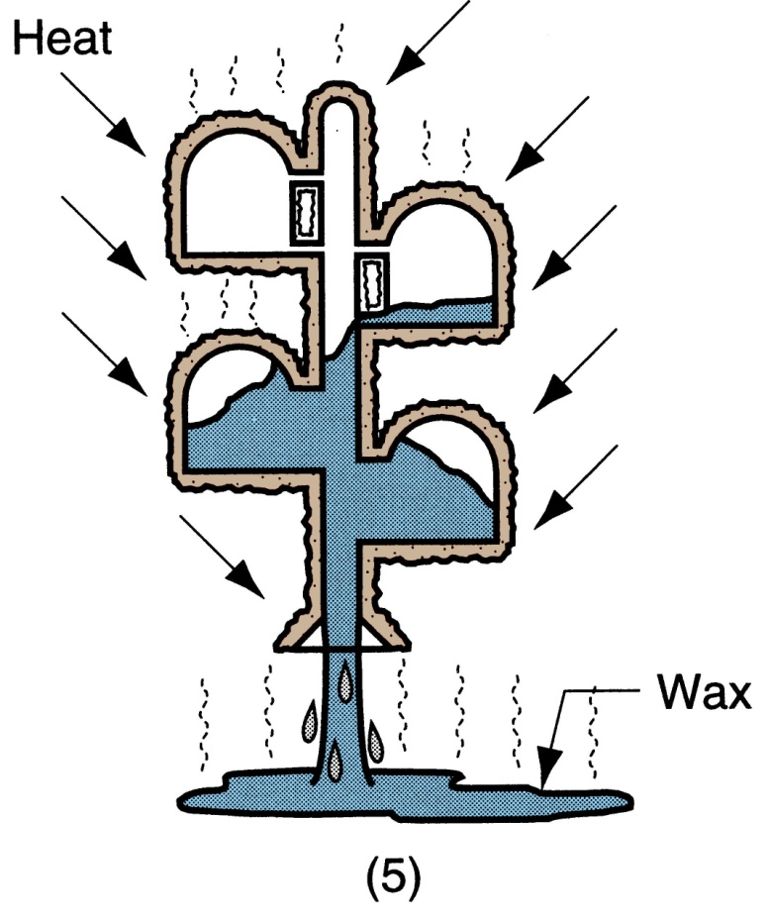
Step 5 :
the mold is held in an inverted position and heated to melt the wax and permit it to drip out of the cavity

Slide 5
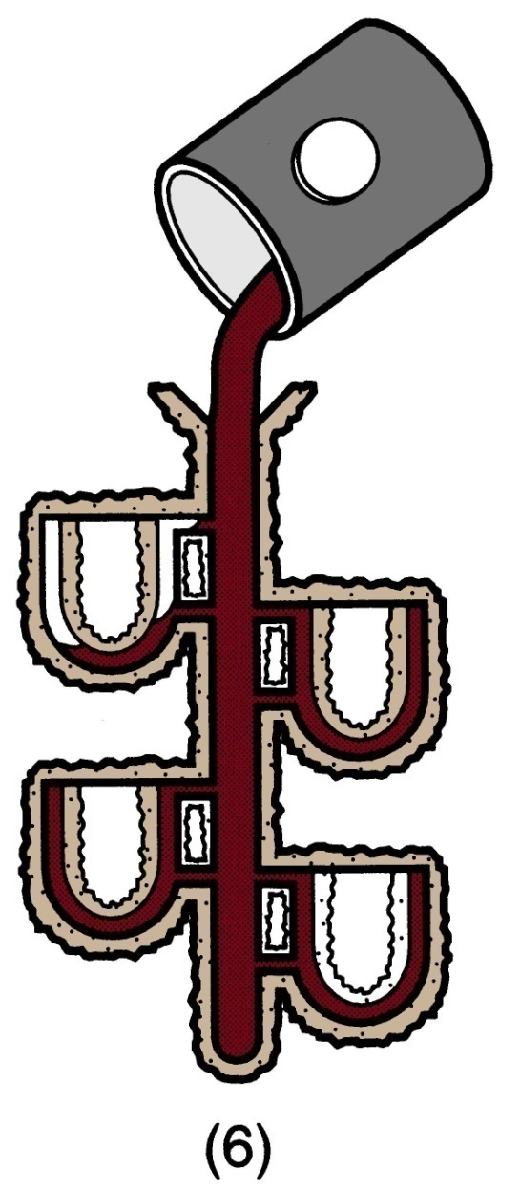
Steps:
(6) the mold is preheated to a high temperature, which ensures that all contaminants are eliminated from the mold; it also permits the liquid metal to flow more easily into the detailed cavity; the molten metal is poured; it solidifies

Slide 6
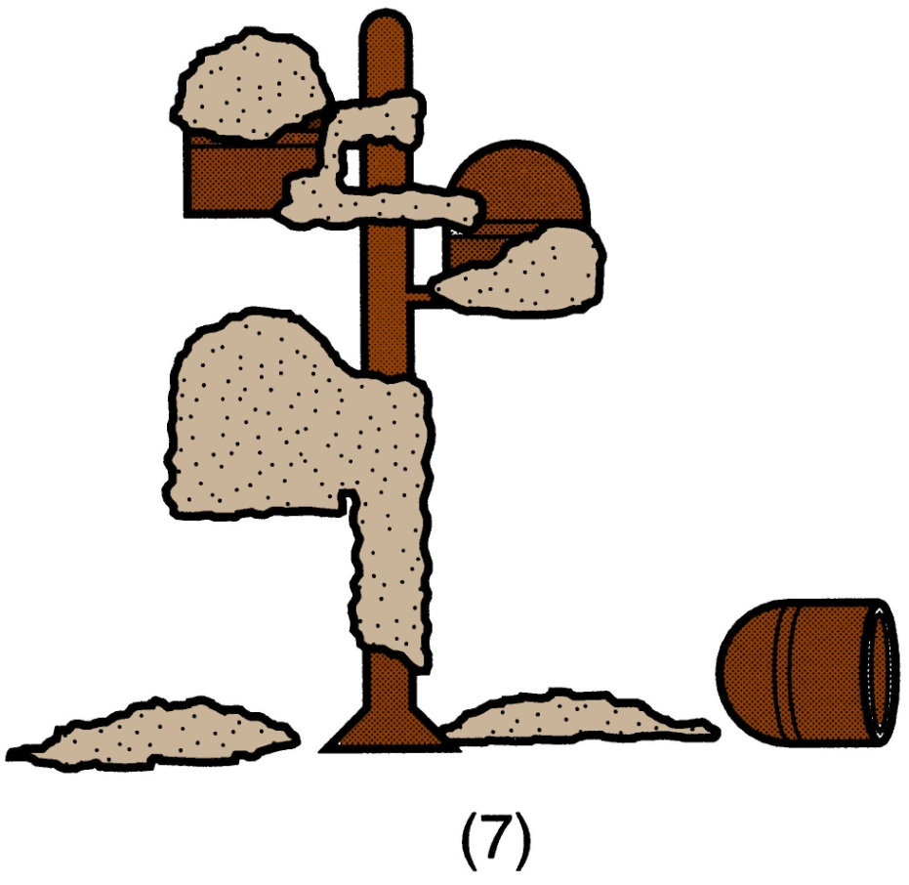
Steps :
(7) the mold is broken away from the finished casting -
parts are separated from the sprue

Slide 7
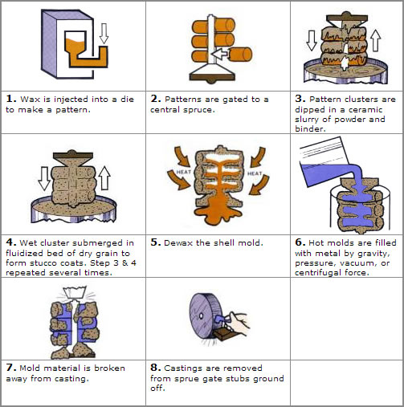

Slide 8
The mold is formed by using a wax pattern which is surrounded, or "invested", into ceramic slurry that hardens into the mold. Investment casting is referred to as "lost-wax casting" because the wax pattern is melted out of the mold after it has been formed. Lox-wax processes are one-to-one (one pattern creates one part), which increases production time and costs relative to other casting processes. However, since the mold is destroyed during the process, parts with complex geometries and intricate details can be created. Investment casting can make use of most metals, most commonly using aluminum alloys, bronze alloys, magnesium alloys, cast iron, stainless steel, and tool steel. This process is beneficial for casting metals with high melting temperatures that can not be molded in plaster or metal. Parts that are typically made by investment casting include those with complex geometry such as turbine blades or firearm components. High temperature applications are also common, which includes parts for the automotive, aircraft, and military industries.

Slide 9
Advantages and Disadvantages of Investment Casting
Advantages:
Parts of great complexity and intricacy can be cast
Close dimensional control and good surface finish
Wax can usually be recovered for reuse
Additional machining is not normally required ‑ this is a net shape process
No parting line

Slide 10
Advantages and Disadvantages of Investment Casting
Disadvantages:
Many processing steps are required
Relatively expensive process
Size limitation, use for less than 0.5 kg
Slow process

Slide 11
Applications of Investment Casting
Milling machine cutters and tools
Jet aircraft nozzles
Jewellary

Slide 12
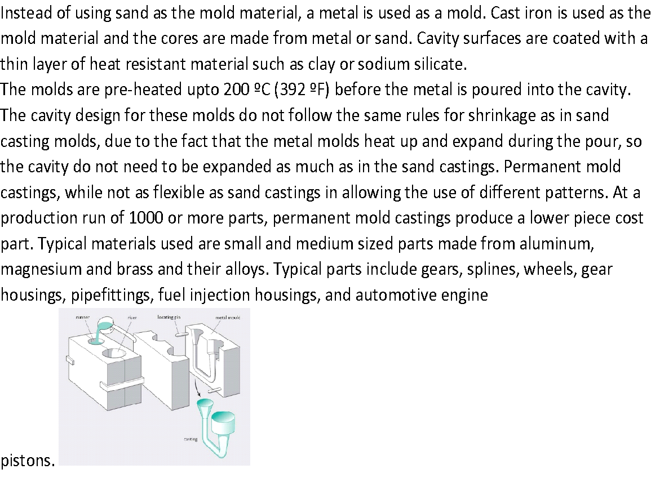

Slide 13
Permanent Mold Casting/ Gravity die casting
Uses a mould which is permanent i.e. mould can be reused many times before it is rebuilt.
mold constructed of two sections designed for easy, precise opening and closing.
Molten metal poured under gravity action.
Mould made up of dense, fine grained and heat resistant metals.

Slide 14
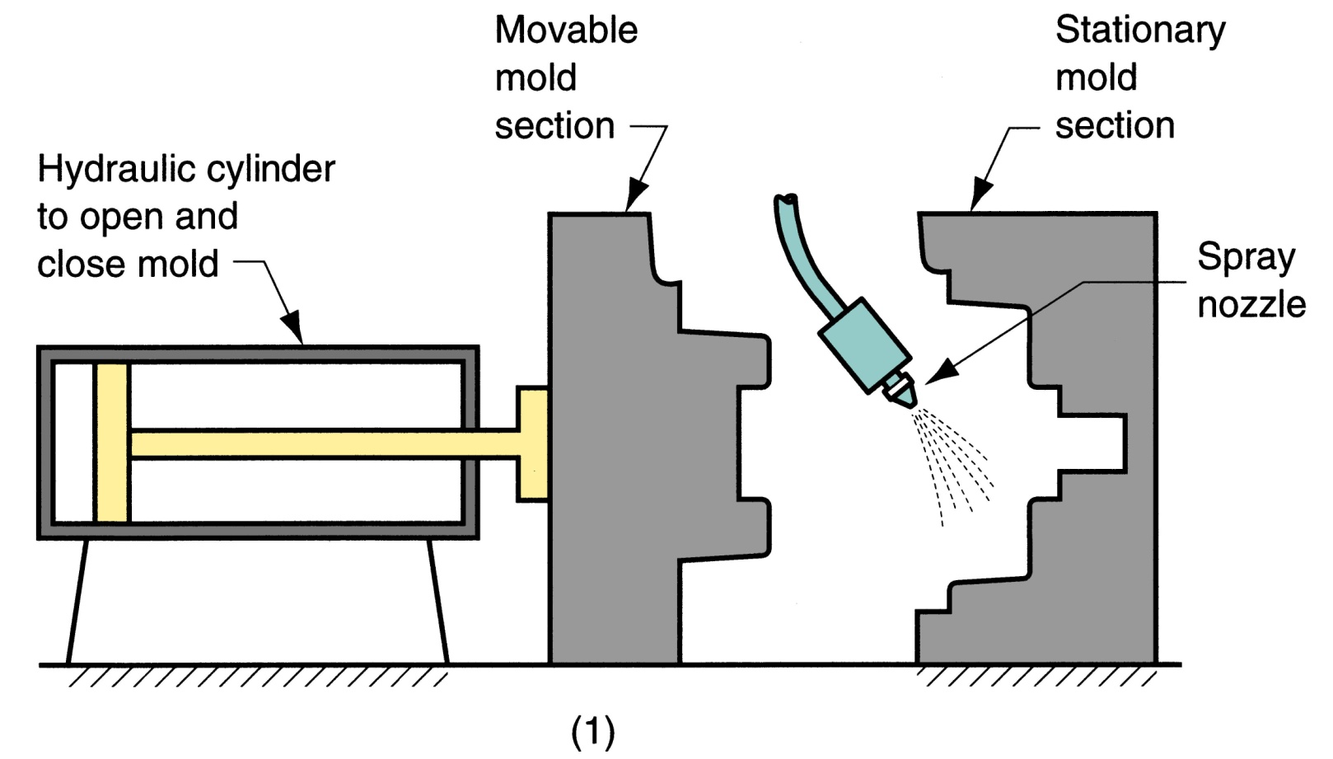
Figure 11.10 ‑ Steps in permanent mold casting:
(1) mold is preheated and coated

Slide 15
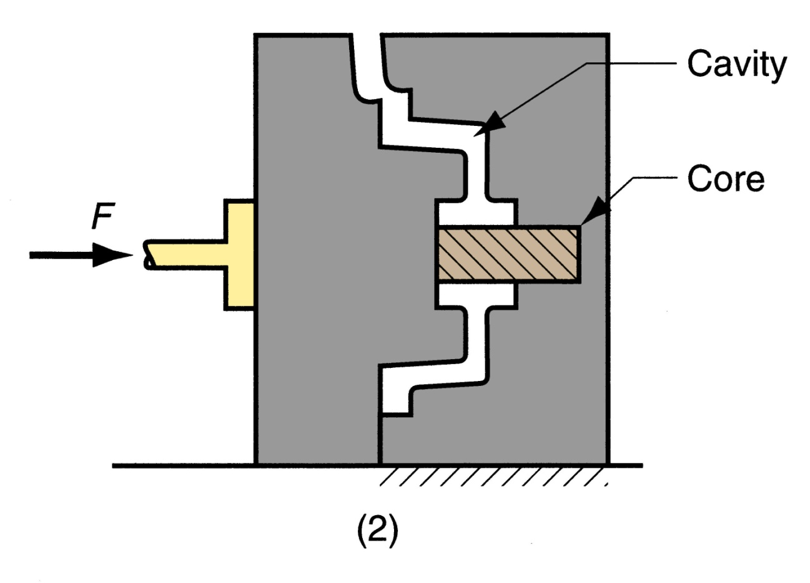
Figure 11.10 ‑ Steps in permanent mold casting:
(2) cores (if used) are inserted and mold is closed

Slide 16
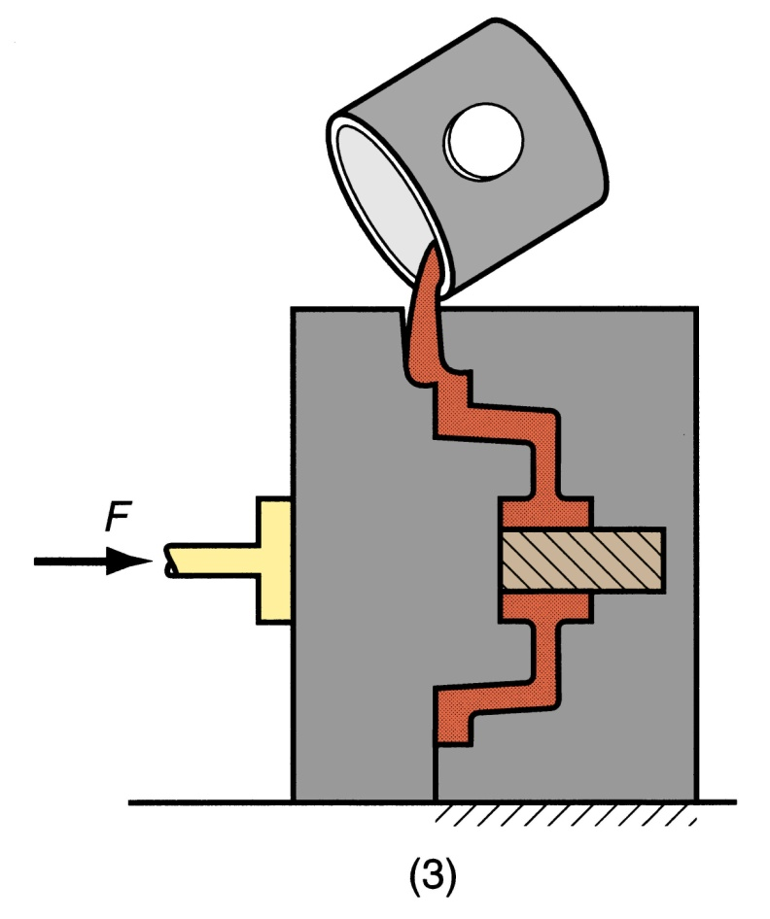
Figure 11.10 ‑ Steps in permanent mold casting:
(3) molten metal is poured into the mold

Slide 17
Advantages and Limitations of Permanent Mold Casting
Advantages:
Good dimensional control and surface finish
High production rate, so use in mass production.
mold results in a finer grain structure, so stronger castings are produced
Limitations:
Generally limited to metals of lower melting point
Complicated shapes can’t be produced.
High cost of mold
Not suitable for all metals.

Slide 18
Applications of Permanent Mold Casting
Due to high mold cost, process is best suited to high volume production and can be automated accordingly
Typical parts: automotive pistons, pump bodies, and certain castings for aircraft and missiles
Metals commonly cast: aluminum, magnesium, copper‑base alloys, and cast iron

Slide 19
Die Casting/ Pressure die casting
Molten metal is forced into a permanent metal mold or die under certain pressure.
Pressure is maintained during solidification, then mold is opened and part is removed
Molds in this casting operation are called dies; hence the name die casting

Slide 20
STEPS
Closing of two halves of die.
Forcing the molten metal under pressure into die.
Holding the two halves together during pouring and solidification.
Opening the two halves and ejecting the casting.

Slide 21
Die Casting Machines
Two main types:
Hot‑chamber machine
Cold‑chamber machine

Slide 22
Hot-Chamber Die Casting
Metal is melted in a container, and a piston injects liquid metal under high pressure into the die
Machine is operated by a hydraulic plunger.
Applications limited to low melting‑point metals that do not chemically attack plunger and other mechanical components
Casting metals: zinc, tin, lead, and magnesium

Slide 23
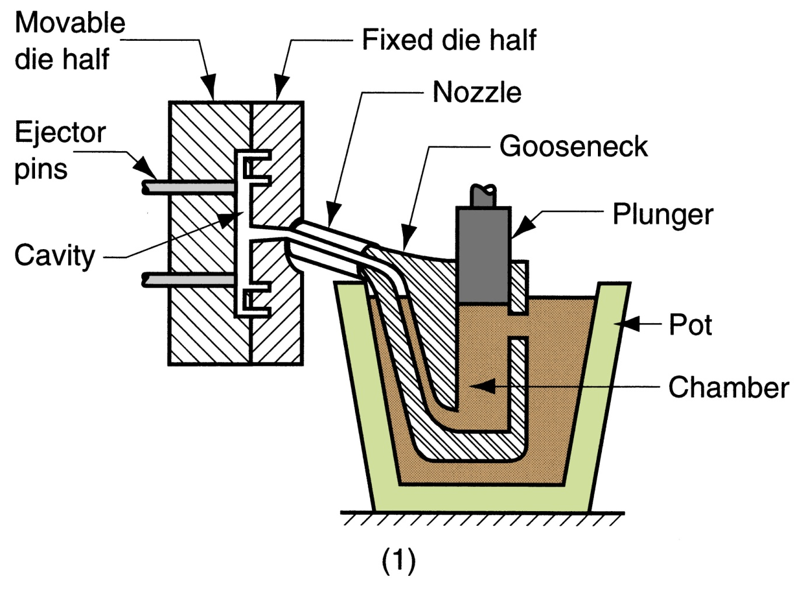
Cycle in hot‑chamber casting:
(1) with die closed and plunger withdrawn, molten metal flows into the chamber

Slide 24
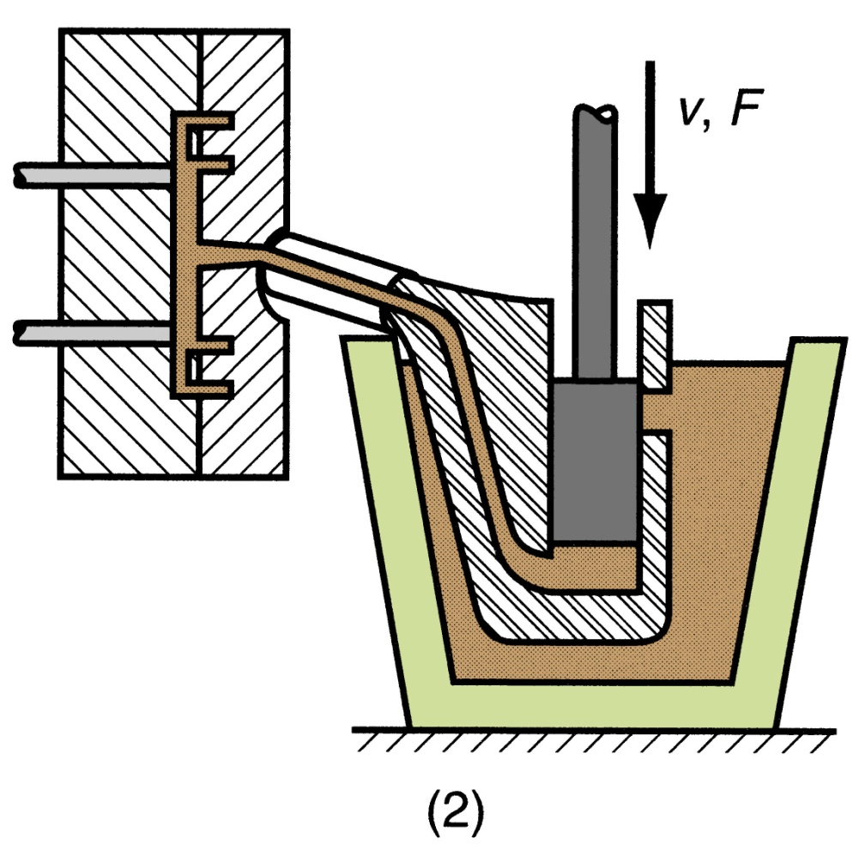
(2) plunger forces metal in chamber to flow into die, maintaining pressure during cooling and solidification

Slide 25
Cold‑Chamber Die Casting Machine
Molten metal is poured into unheated chamber from external melting container, and a piston injects metal under high pressure into die cavity
High production but not usually as fast as hot‑chamber machines because of pouring step
Casting metals: aluminum, brass, and magnesium alloys
Advantageous for high melting‑point alloys

Slide 26
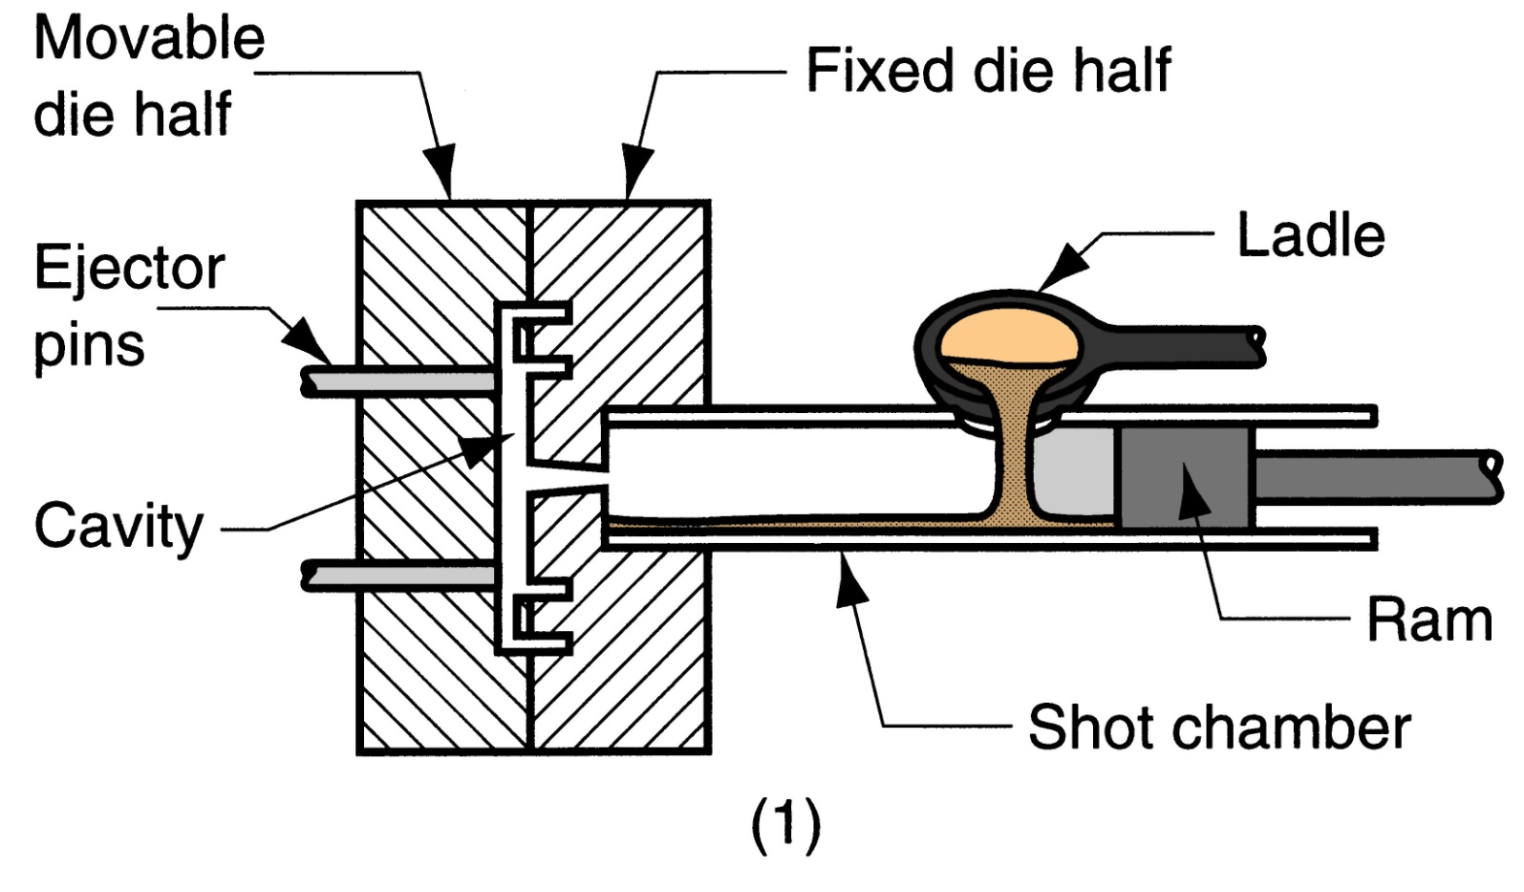
Cycle in cold‑chamber casting:
with die closed and ram withdrawn, molten metal
is poured into the chamber

Slide 27
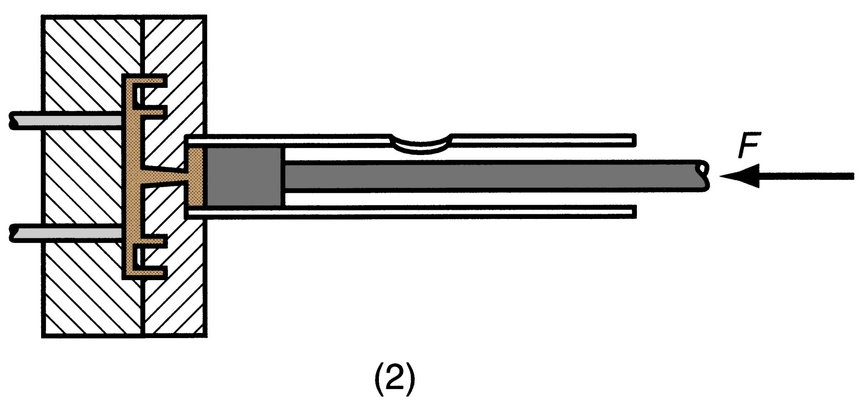
(2) ram forces metal to flow into die, maintaining pressure during cooling and solidification

Slide 28
Advantages and Limitations of Die Casting
Advantages:
Economical for large production quantities
Good dimensional accuracy and surface finish
Thin sections are possible
Rapid cooling provides small grain size and good strength to casting
Disadvantages:
Generally limited to metals with low metal points
Part geometry must allow removal from die cavity
Every metal and alloy can not be cast.
Equipments are costly

Slide 29
Centrifugal Casting
A group of casting processes in which the mold is rotated at high speed so centrifugal force distributes molten metal to outer regions of die cavity
The group includes:
True centrifugal casting
Semicentrifugal casting
Centrifuging casting

Slide 30
True Centrifugal Casting
Molten metal is poured into rotating mold to produce a tubular part
Parts: pipes, tubes, bushings, and rings
Rotational axes can be either horizontal or vertical
Outside shape of casting can be round, octagonal, hexagonal, etc , but inside shape is (theoretically) perfectly round, due to radially symmetric forces

Slide 31
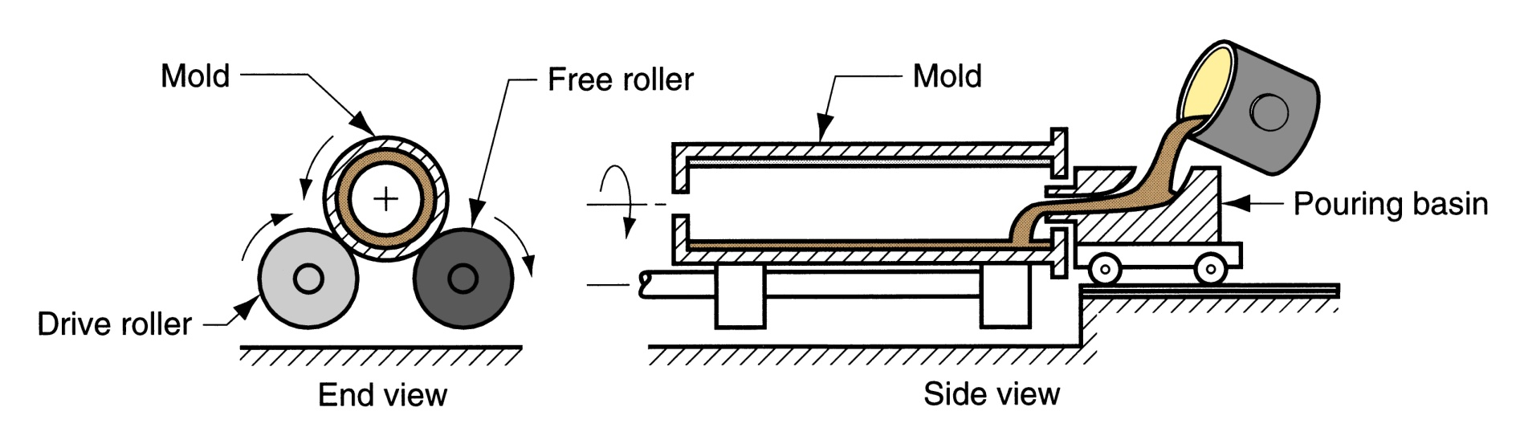
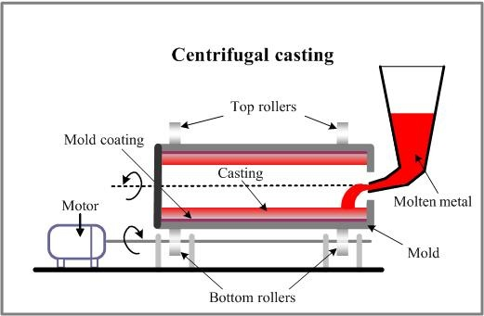

Slide 32
Semicentrifugal Casting
Centrifugal force is used to produce solid castings rather than tubular parts
Molds are designed with risers at center to supply feed metal
Density of metal in final casting is greater in outer sections than at center of rotation
Often used on parts in which center of casting is machined away, thus eliminating the portion where quality is lowest
Examples: wheels and pulleys

Slide 33
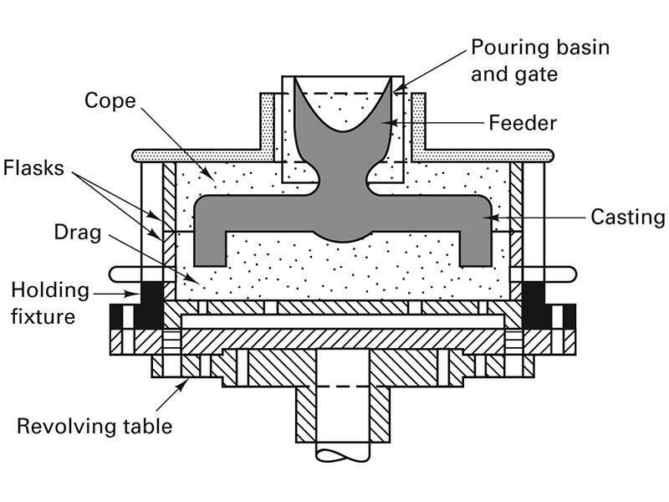
Semicentrifuging Casting
Schematic of a semicentrifugal casting process.

Slide 34
Centrifuge Casting
Use centrifugal acceleration to force metal from a central pouring sprue into separate mold cavities that are offset from the axis of rotation.
Axis of rotation of mold and casting are different
Relatively low rotational speed
Produce casting with thin walls and intricate shapes
Radial symmetry of part is not required as in other centrifugal casting methods

Slide 35
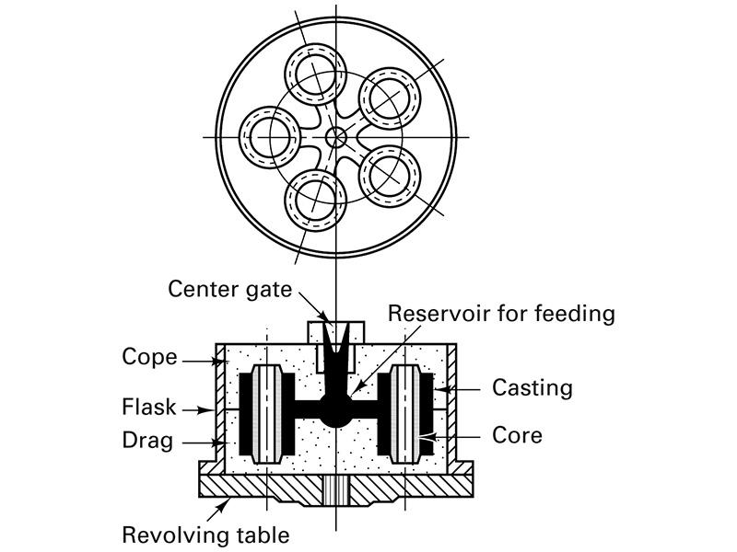
Centrifuging Casting
Metal is poured into the central pouring sprue and spun into the various mold cavities.

Slide 36
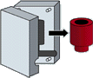
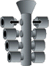
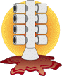
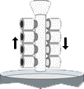
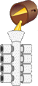
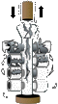
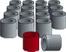
Investment casting (lost wax casting)
(a) Wax pattern
(injection molding)
(b) Multiple patterns
assembled to wax sprue
(c) Shell built →
immerse into ceramic slurry
→ immerse into fine sand
(few layers)
(d) dry ceramic
melt out the wax
fire ceramic (burn wax)
(e) Pour molten metal (gravity)
→ cool, solidify
[Hollow casting:
pouring excess metal before solidification
(f) Break ceramic shell
(vibration or water blasting)
(g) Cut off parts
(high-speed friction saw)
→ finishing (polish)

Slide 37
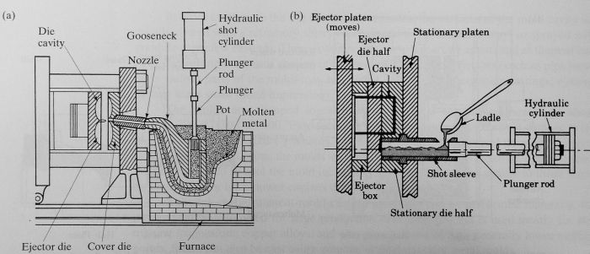
Die casting
- a type of permanent mold casting
- common uses: components for
rice cookers, stoves, fans, washing-, drying machines,
fridges, motors, toys, hand-tools, car wheels, …
HOT CHAMBER: (low mp e.g. Zn, Pb; non-alloying)
(i) die is closed, gooseneck cylinder is filled with molten metal
(ii) plunger pushes molten metal through gooseneck into cavity
(iii) metal is held under pressure until it solidifies
(iv) die opens, cores retracted; plunger returns
(v) ejector pins push casting out of ejector die
COLD CHAMBER: (high mp e.g. Cu, Al)
(i) die closed, molten metal is ladled into cylinder
(ii) plunger pushes molten metal into die cavity
(iii) metal is held under high pressure until it solidifies
(iv) die opens, plunger pushes solidified slug from the cylinder
(v) cores retracted
(iv) ejector pins push casting off ejector die

Slide 38
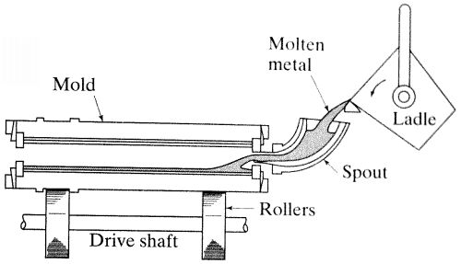
Centrifugal casting
- permanent mold
- rotated about its axis at 300 ~ 3000 rpm
- molten metal is poured
- Surface finish: better along outer diameter than inner,
- Impurities, inclusions, closer to the inner diameter (why ?)

Slide 39
Investment Casting
Also called lost-wax process
First used 4000 – 3000 BC
The pattern is made of wax or of a plastic by molding or rapid prototyping techniques
Term investment derives from the fact that the pattern is invested with the refractory material
Need careful handling because they are not strong enough to withstand the forces involved in mold making
Wax can be recovered and reused

Slide 40
Investment Casting
One-piece mold
Dried in the air
Heated to 90 – 175 C
Held inverted for 12 hrs to melt out wax
The mold is then heated to 650 – 1150 C for about 4 hrs depending on the metal to be cast to drive off the water of crystallization
After the metal has been poured the mold is broken up and the cast is removed
A number of patterns can be joined to make one mold called a tree which increases production rate

Slide 41
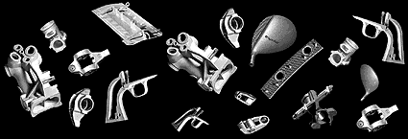
One-piece mold - con’t
Small parts
The tree can be inserted on to a flask and filled with slurry investment
The investment is then placed into a chamber and evacuated to remove air bubbles
Next it is placed in a vacuum drawing machine to produce fine detail
Not a cheap process
Produces fine details
Good surface finish
Few or no finishing operations
Can produce intricate parts from parts weighing 1g – 35Kg
Ex : Investment die casting examples

Slide 42
Permanent-Mold Casting
Called hard-mold casting
Two halves of a mold are made from materials such as iron, steel, bronze, or other alloys
The mold cavity and gating system are machined in to the mold
Sand aggregate are placed in to the mold prior to casting for producing cavities
Typical core materials are
Oil-bonded or resin-boned sand
Plaster
Graphite
Gray iron
Low-carbon steel
Hot-worked die steel
Mold cavity surfaces are coated with refractory slurry to increase the life of the mold every few castings
Mechanical ejectors are used to remove complex parts
Can produce high production rates
Good surface finish

Slide 43
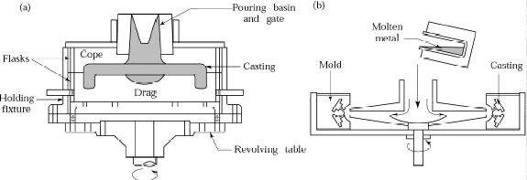
Semi centrifugal Casting Process
(a) Schematic illustration of the semi centrifugal casting process. Wheels with spokes can be cast by this process. (b) Schematic illustration of casting by centrifuging. The molds are placed at the periphery of the machine, and the molten metal is forced into the molds by centrifugal force.

Slide 44
Casting Quality
There are numerous opportunities for things to go wrong in a casting operation, resulting in quality defects in the product
The defects can be classified as follows:
Defects common to all casting processes
Defects related to sand casting process

Slide 45
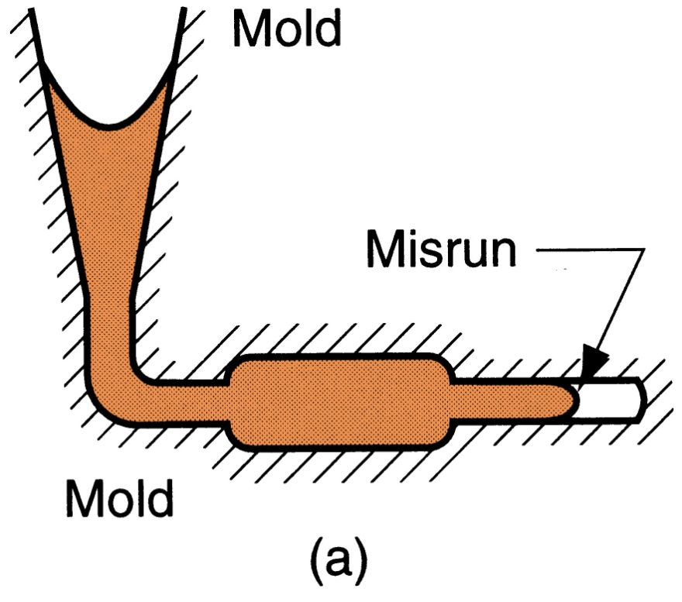
Misrun
A casting that has solidified before completely filling mold cavity
Figure 11.22 ‑ Some common defects in castings: (a) misrun

Slide 46
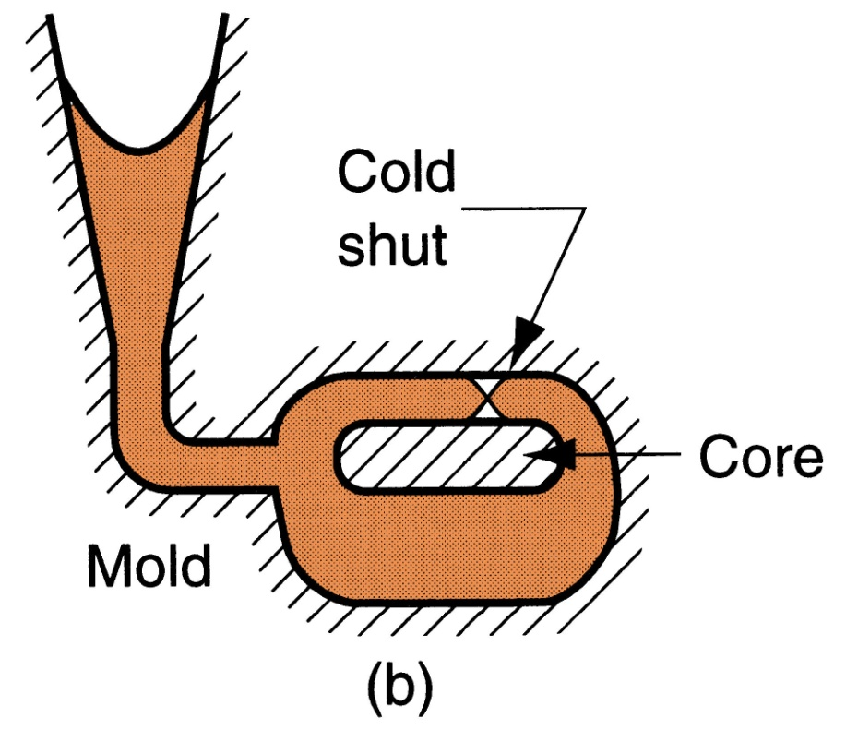
Cold Shut
Two portions of metal flow together but there is a lack of fusion due to premature freezing
Figure 11.22 ‑ Some common defects in castings: (b) cold shut

Slide 47
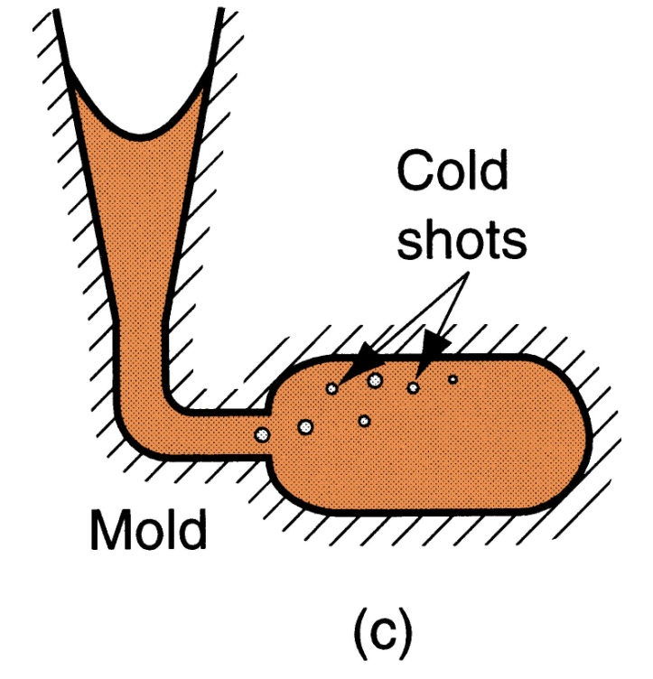
Cold Shot
Metal splatters during pouring and solid globules form and become entrapped in casting
Figure 11.22 ‑ Some common defects in castings: (c) cold shot

Slide 48
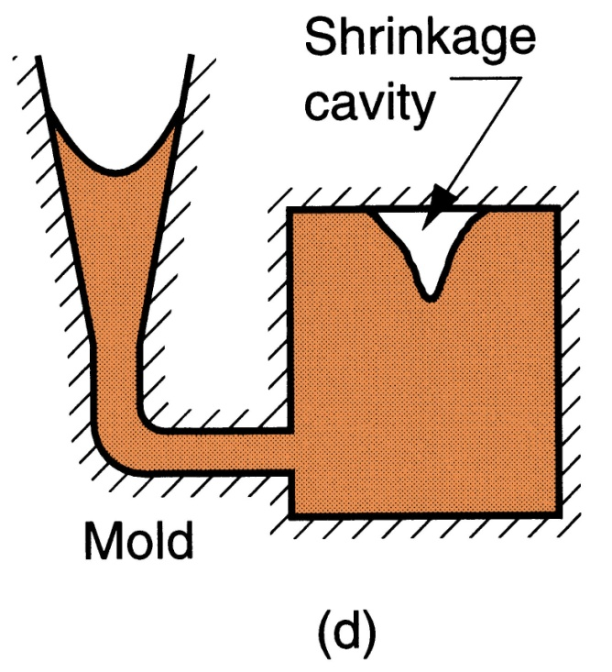
Shrinkage Cavity
Depression in surface or internal void caused by solidification shrinkage that restricts amount of molten metal available in last region to freeze
Figure 11.22 ‑ Some common defects in castings: (d) shrinkage cavity

Slide 49
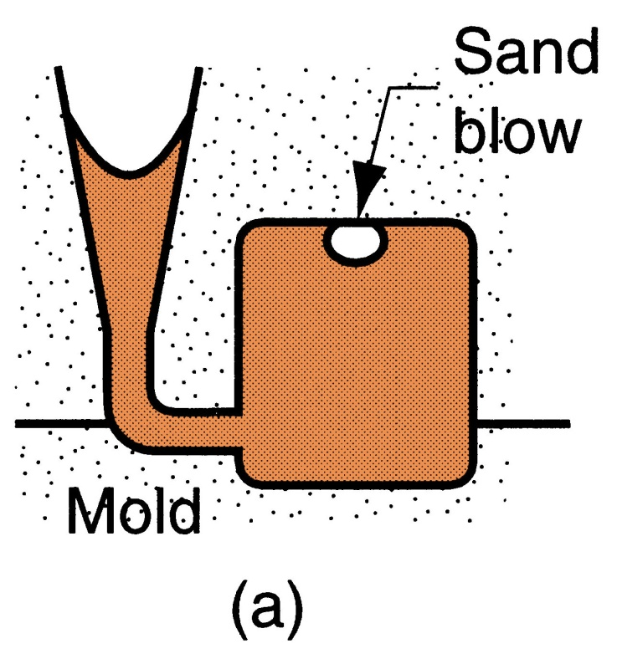
Sand Blow
Balloon‑shaped gas cavity caused by release of mold gases during pouring
Figure 11.23 ‑ Common defects in sand castings: (a) sand blow

Slide 50
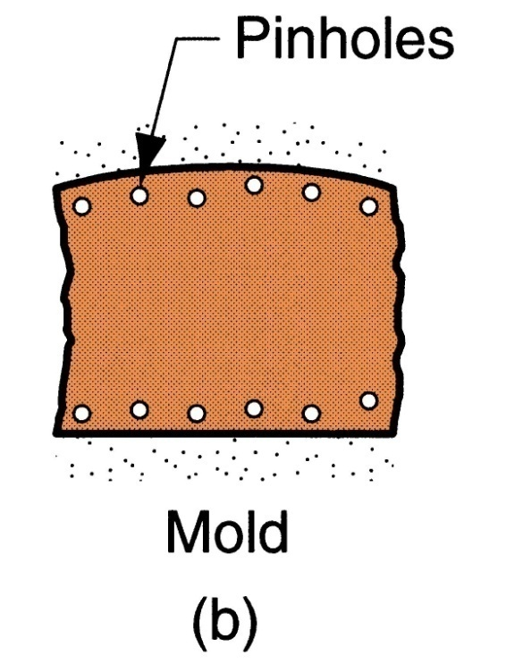
Pin Holes
Formation of many small gas cavities at or slightly below surface of casting
Figure 11.23 ‑ Common defects in sand castings: (b) pin holes

Slide 51
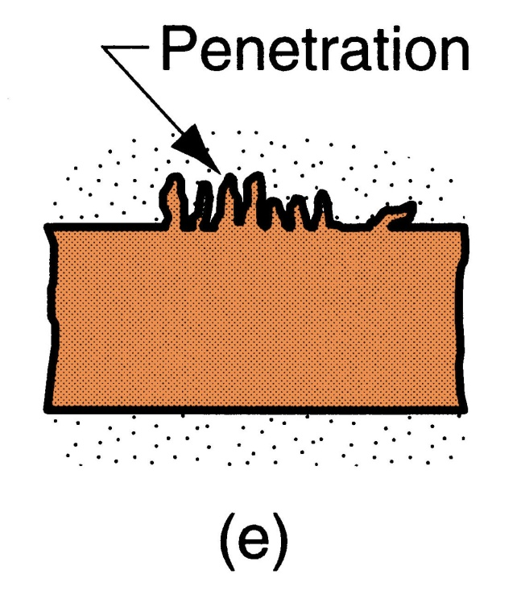
Penetration
When fluidity of liquid metal is high, it may penetrate into sand mold or sand core, causing casting surface to consist of a mixture of sand grains and metal
Figure 11.23 ‑ Common defects in sand castings: (e) penetration

Slide 52
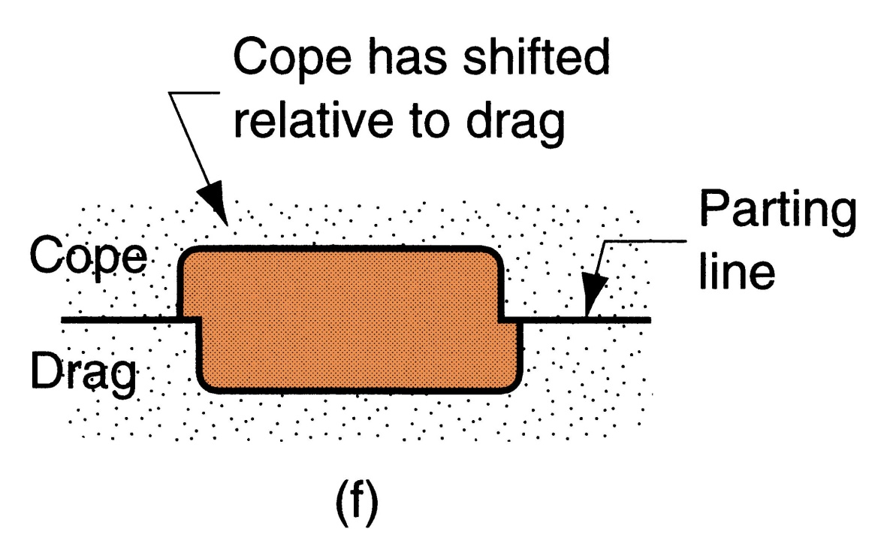
Mold Shift
A step in cast product at parting line caused by sidewise relative displacement of cope and drag
Figure 11.23 ‑ Common defects in sand castings: (f) mold shift

Slide 53
Defects in Casting
Blow Holes
Appears as small round voids opened to the casting surface.
Caused by hard ramming and low permeability sands

Slide 54
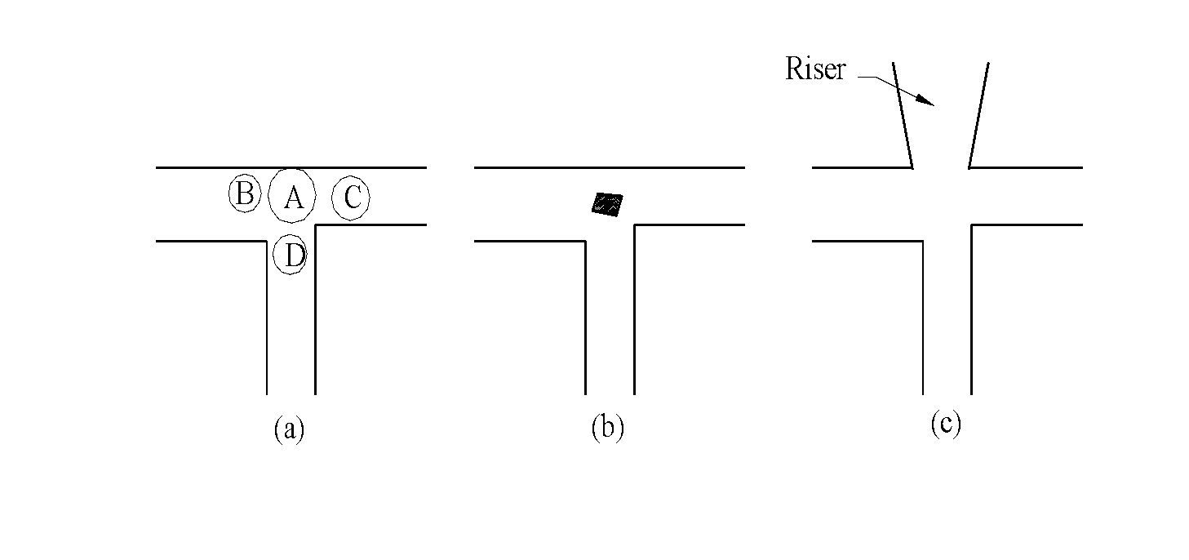
Defects in Casting
Shrinkage Defects
Caused by inadequate feeding of molten metal.

Slide 55
Defects in Casting
HOT TEARS
Appears as external cracks or discontinuities on casting surface.
Caused by hard ramming, too much of shrinkage of molten metal and poor design of casting.

Slide 56
Defects in Casting
MISRUNS
A misrun casting is one that remains incomplete due to the failure of the metal to fill the entire mould cavity.
This can happen when the dimensions of a casting is very less or the metal temperature is too cold, so that the entire section is not filled before the metal solidifies.

Slide 57
Defects in Casting
COLD SHUT
Imperfect fusion of molten metal in the mould cavity.
POUR SHORT
Mould cavity is not completely filled for the want of molten material.
INCLUSIONS
Foreign material present within the metal of a casting. An inclusion may be oxides, slag, etc

